Slide 1
Partitioning Algorithm and Initial Results

Slide 2
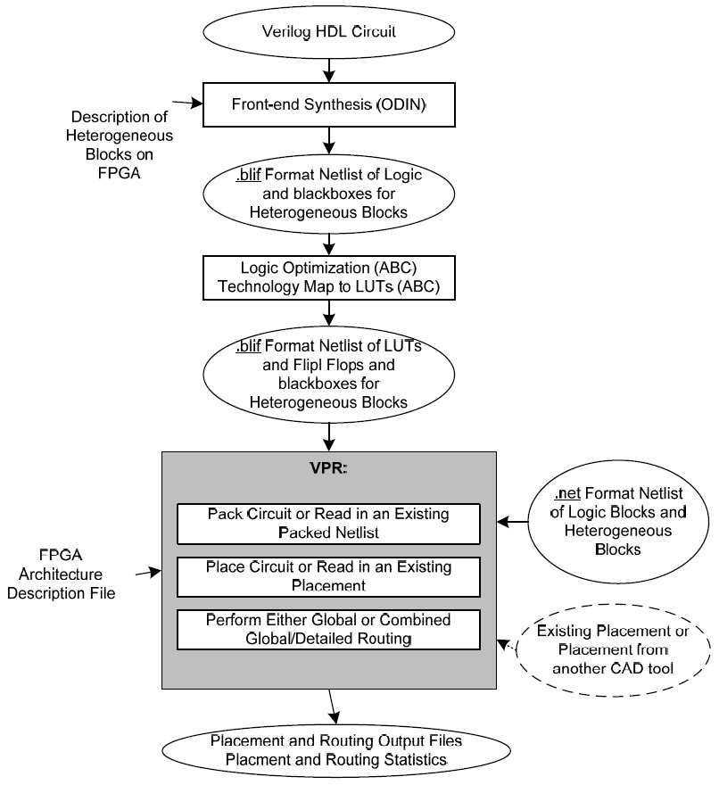
Workflow
Synthesis
Optimisation
Partitioning
Split
Triplicate
Join
Flatten
Packing
Placing
Routing
CAD Design Flow (VPR Manual)

Slide 3
Blif Format
Text format.
List of elements/nodes. Latches and Combinational Logic.
Each node has text describing inputs, outputs, element.
E.g (And Gate):
.names in1 in2 out
11 1

Slide 4
Algorithm
Read network into memory
Traverse breadth first from outputs
Add node to new partition until partition full
Write partition to file
Continue until each node has been visited once
Treat each partition as black box and triplicate it
Treat each TMR partition as black box and join them

Slide 5
Algorithm – Adding Node
Insert node into network and create signals
Recursively traverse network keeping track of visited nodes
If an already visited node is reached, cut link between node and parent

Slide 6
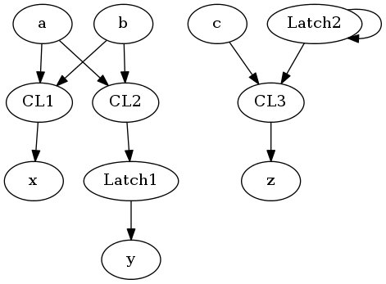
Example
.model main
.inputs a b c
.outputs x y z
.clocks pclk
.names a b x
11 1
.names a b [1]
10 1
01 1
.latch [1] y re pclk 2
.latch [2] [2] re pclk 2
.names c [2] z11 1
.end

Slide 7
Example – End Result
# Benchmark "main" written by ABC on Wed Mar 13 02:18:50 2013
.model main
.inputs a b c
.outputs x y z
.latch n31 main|p1output(1)|[qq40] 2
.latch n34 main|p1output(1)|[qq10] 2
.latch n40 main|p1output(1)|[qq41] 2
.latch n43 main|p1output(1)|[qq11] 2
.latch n49 main|p1output(1)|[qq42] 2
.latch n52 main|p1output(1)|[qq12] 2
.names a b n25
11 1
.names c main|p1output(1)|[qq10] n26
11 1
.names a b n31
10 1
01 1
.names a b n28
11 1
.names c main|p1output(1)|[qq11] n29
11 1
.names a b n40
10 1
01 1
.names a b n31_1
11 1
.names c main|p1output(1)|[qq12] n32_1
11 1
.names a b n49
10 1
01 1
.names n26 n29 n32_1 z
11- 1
1-1 1
--1 1
.names n25 n28 n31_1 x
11- 1
1-1 1
--1 1
.names main|p1output(1)|[qq40] main|p1output(1)|[qq41] \
main|p1output(1)|[qq42] y
11- 1
1-1 1
--1 1
.names main|p1output(1)|[qq10] n34
1 1
.names main|p1output(1)|[qq11] n43
1 1
.names main|p1output(1)|[qq12] n52
1 1
.end

Slide 8
Algorithm
1. Read entire file into memory, and represent it as a graph.
Each Model has a list of nodes and map of signalName->Signal
Each signal points to its source and sinks
Each node has a list (string) of inputs and outputs (+type, etc).
Why do nodes have strings, which are looked up in a map to the signal, which points to the node? Why not have each node just point to the other node? Because of the way models are made and manipulated.

Slide 9
Algorithm 2
2. Traverse
Start at one end, adding connected nodes to partition. Once partition reaches limit, write it out, remove those nodes from the network, and repeat.
Specifically, start at outputs not inputs due to e.g. [IMAGE]
3. Adding to Partition
Add to node collection
Update Signals
Recalculate critical path (max cost without cycles)

Slide 10
Algorithm 3
model = network->MainModel
FOREACH output in model
q.Add(output->source)
partition = new EmptyModel
WHILE node = q.pop
IF visited(node)
CONTINUE
IF partition+node > limits
WriteModelToNewFile(partition)
partition = new EmptyModel
partition.Add(node)
FOREACH input in node->inputs
q.Add(input->source)
WriteModelToNewFile(partition)
Model::Add(node)
nodeCollection.Add(node)
UpdateSignals(node)
inCost = MaxInputCost
UpdateCosts(node, inCost)
Model::UpdateCosts(node, inCost)
nodeCost = inCost+InnateCost
MarkVisited(node)
FOREACH sink in node->sinks
IF visited(sink)
Cut(node, sink)
ELSE
UpdateCosts(sink, nodeCost)
//Rename the signals, then after TMR we can rejoin them outside the partition
Model::Cut(source, sink)
source->output = "SpecialOut"+source->output
sink->inputs[source->output] = "SpecialIn"source->output
Model.AddInput("SpecialIn"source->output)
Model.AddOutput("SpecialOut"+source->output)

Slide 11
Cycle Detection
CutCycles(Node* parent, Signal sig)
node = sig->source
if(exploring[node] == true)
CutLoop
else
exploring[node] = true
FOREACH(signal in node->inputs)
CutCycles(node, signal)
exploring[node] = false

Slide 12
White is unvisited, grey is exploring, black is finished
Cycle

Slide 13
Results
Use very small partitions, to magnify effect.
Routing is still the dominant contributor to time spent in workflow.
Latency from 10%-80% increase.
Area, number of elements, etc, all more or less triple.
Number of nets on the critical path usually increases, sometimes decreases.

